Slide 1
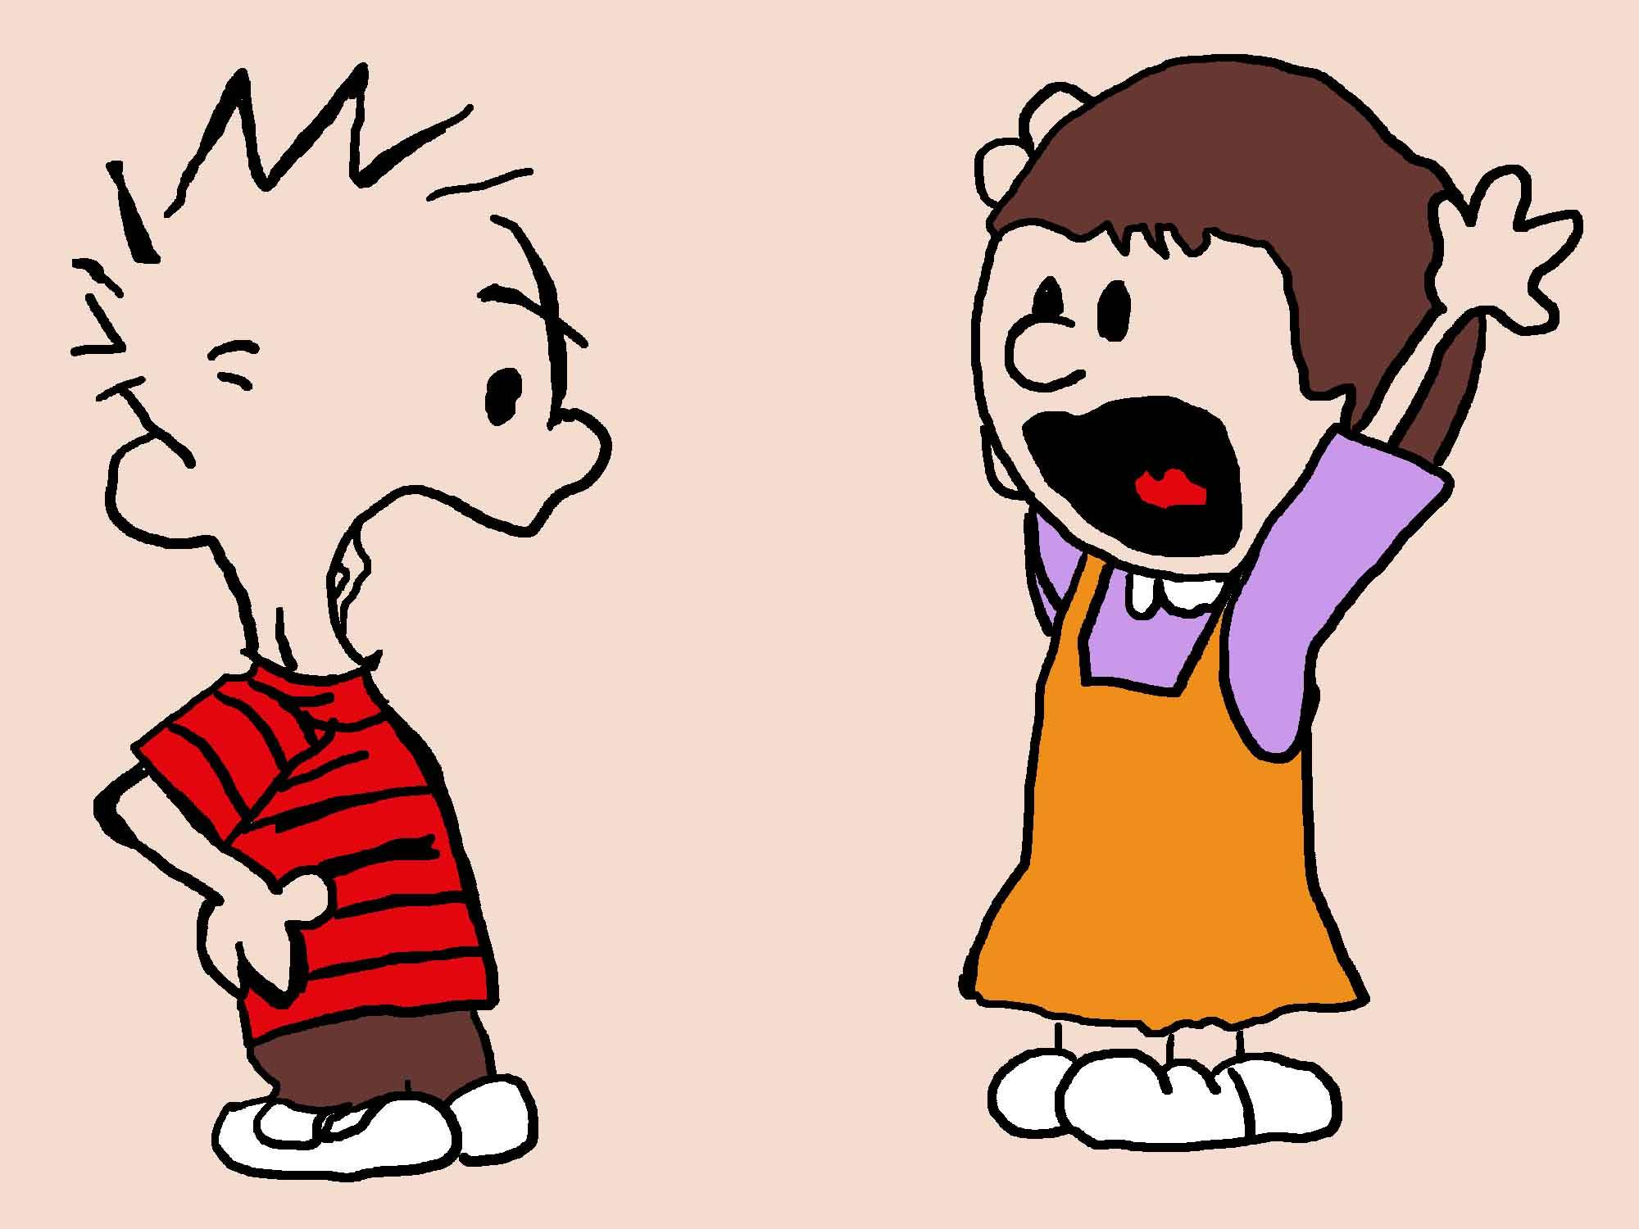
Let’s talk ARGUMENT
Friday December 14th
Our Student targets:
I can explain the structure of an argument essay
I can analyze the argument in a model essay.
I can analyze how the author of the model essay acknowledges and responds to a counterclaim.
I will make my choice on what I will argue for Midsummer Night’s Dream
Notes:
Standards:
Long Term: W8.1- Write arguments with evidence and clear reasons of support
Short Term: RI8.8 - Identify argument and specific claims in text
Short Term: RI8.6 - Analyze how an author aknowledges and responds to conflicting points of view

Slide 2
Video #1
Video #2
Turn and Talk….
What are the parts of a written argument?
What will be challenging?

Slide 3
Model Argument
Should Skateboarding be added to After School Activities?
Your Task: Read and Annotate for the following with your partner...

Slide 4
Take a word count of each paragraph
In 1st paragraph, highlight the Primary Argument Claim or THESIS
Identify the “hook” with “H”
Underline focus reasons in 1st paragraph that will be talked about
In the 2nd and 3rd paragraphs, highlight the supporting claims or the BIG REASONS connected to the THESIS (Label with SC)
Label direct quotes with Q and underline
Annotate how well the reasons were elaborated upon
The 4th Paragraph should address the “Counter Claim.” Highlight the counterclaim and label it “CC”
Annotate on how well the counterclaim was proved to be not really valid. We call this the “rebuttal” of the argument.
FINALLY, read over the conclusion. This conclusion is weak. Annotate why. Re-write the conclusion.
Partner Work!!!

Slide 5
The character of Helena is depicted as a WEAK person. Yes or No? Make your argument | The character of Demetrius is depicted as a BULLY. Yes or no? Make your argument | The character of Hermia is depicted as a self-centered woman. Yes or no? Make your argument | The character of Lysander treats women fairly. Yes or no? Make your argument | Challenge: Without the character of “Puck,” Shakespeare’s play would have lost its value as a comedy. Yes or No? Make your argument | Challenge: Shakespeare makes a good case that it is possible to control another person’s actions. Yes or No? Make your argument
Make a choice! You will get a strip. Read carefully and decide what you want to argue.

Slide 6
Start your introduction
Create a “hook”
Make sure you give a brief creative summary to draw the reader in
Have the Play name and author
Include your THESIS statement or main claim of your argument
Make sure you decide your two supporting claim reasons

Slide 7
Model Shakespeare Essay Introduction:
Sometimes, the person who thinks he is the most in control of a situation turns out to be the biggest fool of all. Control is a major theme in A Midsummer Night’s Dream by William Shakespeare. In the play, each character tries to make someone else do what he or she wants. One example is Puck, a mischievous fairy working for Oberon, the fairy king. Puck loves manipulating other people for his own amusement. One of the people he toys with is a young woman named Helena. Helena tries to force Demetrius, her best friend’s fiancé, to love her. Ultimately, Shakespeare makes the case that it is not possible to control another person’s actions, because the results are unpredictable and temporary.

