Slide 1
Page 34
Reconstruction
(1865-1876)

Slide 2
Key Questions
How do we bring the South back into the Union?
What branch of government should control the process of Reconstruction?
How do we rebuild the South after its destruction during the war?
How do we integrate and protect newly- emancipated black freedmen?

Slide 3
RECONSTRUCTION PLANS
Lincoln’s Plan
Johnson’s Plan
Congressional Plan

Slide 4
President Lincoln’s Plan
The 10% Plan
Proclamation of Amnesty and Reconstruction
Replace majority rule with “loyal rule” in the South.
He didn’t consult Congress regarding Reconstruction.
Wanted to make the South’s transition as easy as possible
Wanted to minimize bitterness and anger so country could move forward

Slide 5
President Lincoln’s Plan
The 10% Plan
Pardon to all but the highest ranking military and civilian Confederate officers.
States had to allow slaves to remain free
When 10% of a state’s voting population in the 1860 election had taken an oath of loyalty and established a government, that state re-admitted.

Slide 6
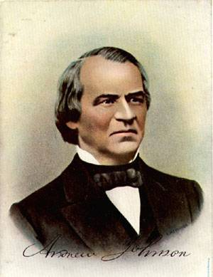
President Andrew Johnson
Abraham Lincoln assassinated by Confederate sympathizer John Wilkes Booth on April 15, 1865
Vice President Andrew Johnson inherits the Presidency and the issue of Reconstruction after Lincoln’s death
Agreed with Lincoln that states had never legally left the Union.
Felt that the wealthy southerners were the ones responsible for secession, so they should face the consequences
Wanted to spare poor southerners too many penalties

Slide 7
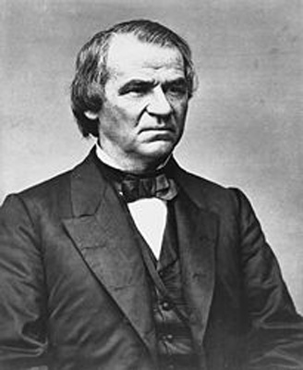
PRESIDENT JOHNSON’S PLAN
Johnson thinks Lincoln’s plan a bit too lenient
Comes up with a similar plan that is slightly tougher
10% of voters have to take loyalty pledge (like Lincoln’s plan)
Adds the requirement of a presidential pardon for former Confederate government and military officers and southerners owning property over $20,000
States had to abolish slavery and ratify the 13th amendment

Slide 8
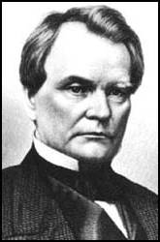
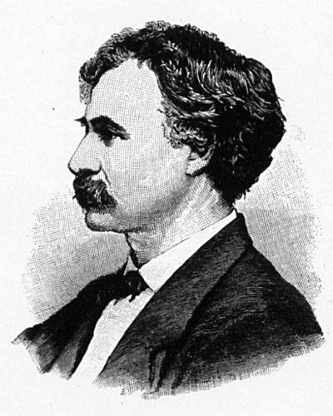
THE CONGRESSIONAL PLAN
Known as the Wade-Davis bill, after its sponsors
Congress felt the south should face harsh punishment for its actions
Required 50% of the number of 1860 voters in a state to take an oath of allegiance (swearing they had never voluntarily aided the rebellion ).
Required a state constitutional convention before the election of state officials.
Enacted specific safeguards of freedmen’s liberties.
States had to ban slavery
Only after all these criteria were met would states be readmitted to the Union
Senator Benjamin Wade (R-OH)
Congressman Henry W. Davis (R-MD)

Slide 9
13th Amendment
Passed to ensure the permanent removal of slavery since Emancipation Proclamation only addressed the Confederate states
Ratified in December, 1865.
Made slavery illegal throughout the United States
Former slaves now free to marry legally and to travel without documentation
Many demanded the same economic and political rights as whites, though they were unprepared for what to do with those rights

Slide 10
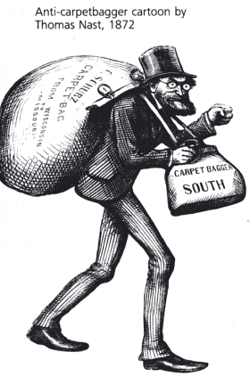
Freedmen’s Bureau (1865)
Established to provide relief for poor southerners—white and black.
Distributed food to the poor, helped to find housing and employment
Many former northern abolitionists came south to help southern freedmen.
These people often called “carpetbaggers” by white southern Democrats.
Often faced with risky situations due to anti-northern sentiments
Freedmen’s Bureau also helped to promote education in the south
Began to open schools for blacks
Eventually opened more than 3,000 schools, and went on to establish several colleges including Fisk University in Nashville, TN and Howard University in Washington, DC

Slide 11
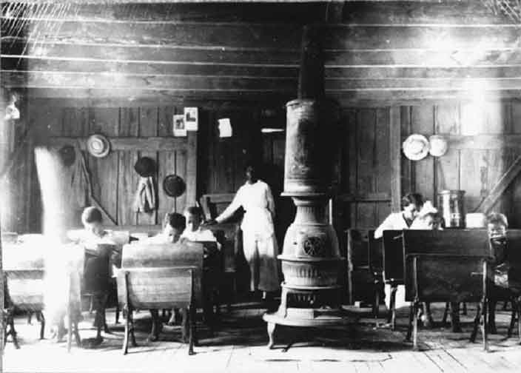
Freedmen’s Bureau School

Slide 12
Growing Northern Alarm
Many Southern state constitutions fell short of minimum requirements.
Johnson granted 13,500 special pardons.
In the first two years of Reconstruction, just one state was readmitted to the Union (TN in 1866)
Revival of southern defiance
BLACK CODES

Slide 13
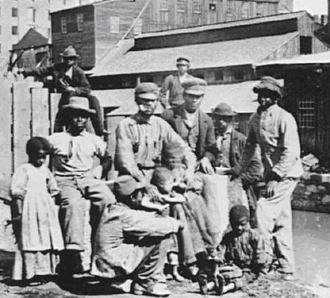
Black Codes
An improvement over slavery, but blacks still had restrictions that whites did not endure
Blacks could own certain types of property, could testify in cases involving other blacks, and existing marriages proclaimed legal
Blacks could still not allowed to vote or serve on a jury, prevented from renting or leasing land, and forced into strict labor contracts
*labor contracts could come with high fines and forced unpaid labor if contracts broken
Restored pre-war system of race relations. (Whites with power, blacks with little/no power)

Slide 14
 | How South will be brought back to the Union | Consequences faced for secession | Plan for Freed Slaves
Lincoln’s Reconstruction Plan | 10% of 1860 voting population will take oath of loyalty State government re-established | Very few Wanted easy transition Wanted to minimize anger and bitterness | States had to allow slaves to remain free
Johnson’s Reconstruction Plan | 10% of 1860 voting population would take oath of loyalty State governments to be re-established | Wealthy southerners, Confederate government officials and military had to have presidential pardon | States had to ratify 13th amendment
Congressional Reconstruction Plan | 50% of voting population had to swear oath of allegiance | Had to re-write state constitution 50% of population had to swear never voluntarily part of Confederacy | Specific protections States had to ban slavery

