Slide 1
Reconstruction Vocabulary
Reconstruction- The period after the Civil War where the South was rebuilt
13th Amendment- Abolished,slavery and involuntary servitude
14th Amendment- Defines citizenship, prevents states from interfering with the rights of citizens of the United States
15th Amendment- Extended the right to vote to African American men

Slide 2
Reconstruction Vocabulary
Freedmen’s Bureau- A federal agency set up by Congress in 1865 to provide food, clothing, shelter, and education for former slaves
Jim Crow Laws- Segregation laws that separated the races, particularly in public places like city parks and schools

Slide 3
Reconstruction Vocabulary
Ku Klux Klan- An organization that developed into a secret, racist organization whose purpose was to return political and social control to native whites.
Impeach- The process of bringing formal charges against a public official
Carpetbaggers- One who came to NC from a northern state to gain power and fortune

Slide 4
Reconstruction Vocabulary
Scalawags- A southern white man or woman who opposed secession
Sharecropping- A person who rents a plot of land and farms it in exchange for a share of the crop

Slide 5
Reconstruction
1865-1877

Slide 6
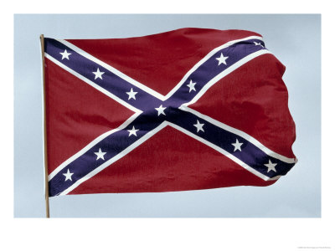
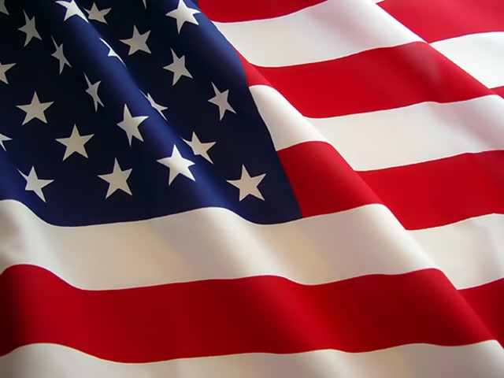
Reconstruction
The period after the Civil War where the South was rebuilt.

Slide 7
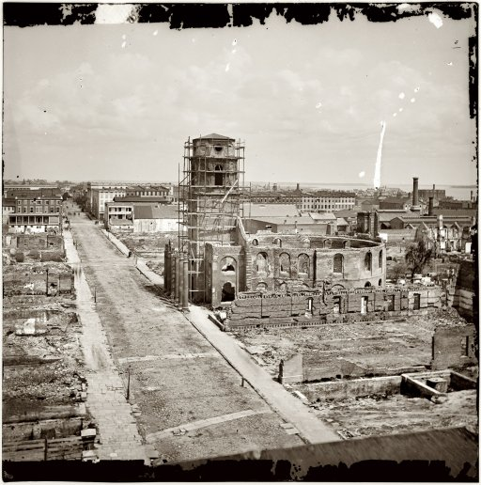
Charleston, SC

Slide 8
Destruction in the South
Cities and plantations were destroyed.
Railroads destroyed.
250,000 Confederate soldiers died during the war. Thousands were wounded.
4 Million slaves were freed.
Economy was ruined.
Confederate money was worthless!
Banks went under, and life savings were lost.

Slide 9
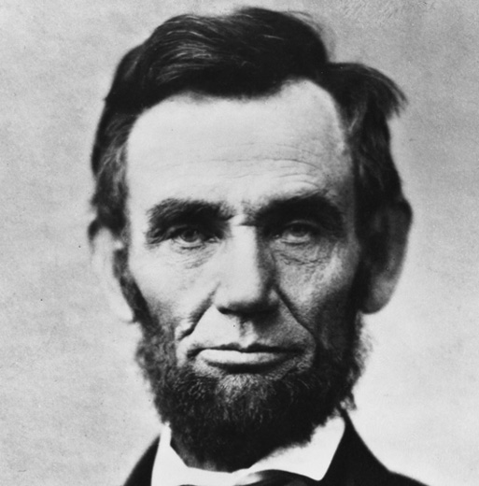
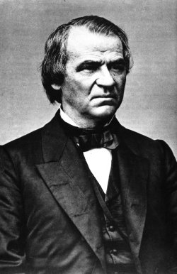
Presidential Reconstruction
(Lincoln/Johnson)

Slide 10
Lincoln’s 10 Percent Plan
Wanted to make it easy for states to rejoin the Union.
When 10% of the states voters swore an oath of loyalty to the United States, the voters could create a new government.
The new government would have to declare an end to slavery. (13th Amendment!)
Gave former Confederates amnesty: a group pardon.
*Did not apply to Confederate government leaders and top military officers.

Slide 11
Freedman’s Bureau
It was imperative to deal with the needs of freedmen, enslaved people who had been freed by the war.
Schools were set up to teach freedmen how to read and write.
Public schools in the south now taught blacks and whites.
The F.B. also helped people find jobs, and resolved disputes between whites and blacks.

Slide 12
Assassination!
President Lincoln had hoped for a peaceful Reconstruction but he had no time to put his plans into practice.
On April 14, 1865 he was shot and killed.
John Wilkes Booth slipped up behind Lincoln and his wife while there were attending a play at Ford’s theater in Washington. He died two hours later.
Booth was later shot after pursuers trapped him in a barn and set it on fire.
8 people were convicted and 4 hanged for their parts in Lincoln’s death.

Slide 13
Andrew Johnson
After Lincoln’s death Johnson, the VP, takes over as President.
First, the 13th amendment is established to ABOLISH SLAVERY.
Johnson’s Plan: Each state had to abolish slavery and ratify the 13th amendment. They would also be allowed to organize new governments and elect representatives to Congress.

Slide 14
Review Questions
Who was the first President during Reconstruction?
What was his plan for rebuilding the nation called?
Who was the second President during Reconstruction?
Describe the parts of his plan.
Notes:
Abraham Lincoln, 10% Plan, Andrew Johnson, Abolish slavery, Adopt 13th Amendment, rebuild state governments.

Slide 15
Black Codes
In a series of public meetings, the committee heard testimony about black codes new laws used by southern states to control African Americans.
Anger at these developments led Congress to be even harsher.
The Radical Republicans took the lead and began to implement two major goals.
To prevent former Confederates from gaining control over southern politics.
Protect freedmen and guarantee them a right to vote.

Slide 16
Reconstruction Act of 1867
Passed by the Radical Republicans (new leaders) in congress.
Divide the South into 5 military districts.
10 out of the 11 states would be under military rule.
Had to pass the 13, 14 (A-A Citizenship), 15 (A-A- right to vote) amendment.
Must write a new Constitution before returning to the Union.
Anyone with ties to the Confederacy couldn’t hold office.

Slide 17
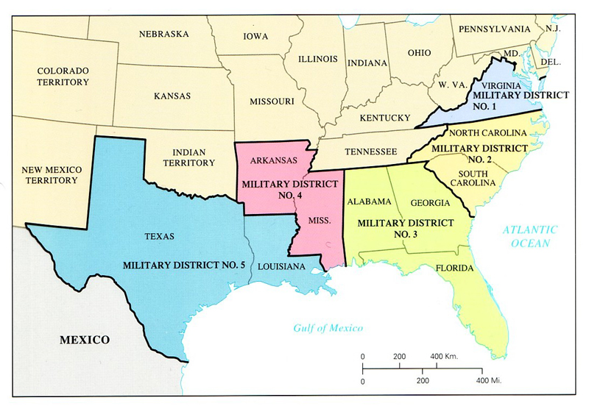

Slide 18
Response to Radicals
Scalawags: Southern whites who oppose secession.
Freedmen: African Americans no longer enslaved.
Carpetbaggers: Northern whites who went south to start a business or purse political office.

Slide 19
What happens next? . . .
Radicals tried to impeach President Johnson. He escaped by one vote!
In time, a new president was elected: Ulysses S. Grant.
With his election, the “Radical Republicans” began to lose power. With this loss, many resulted to violence.
They created the KKK or Ku Klux Klan to scare African Americans.

Slide 20
Things didn’t get better for all people in the South.
Southern states passed laws to limit A-A from voting. (Giving literacy tests, poll taxes, grandfather clause)
Jim Crow Laws passed, enforcing segregation.
Plessy vs. Ferguson: separate but equal.
Freedmen now worked as sharecroppers.
1877 Rutherford Hayes removes military troops from the South.

Slide 21
End of Reconstruction

